Slide 1

Multimodal Personalized Multiuser Home Assistant
Multimodal Interaction,
Project Presentation
Spring 2021
MSc Computer Science
Giulio Attenni & Gabriel Radu Taranciuc

Slide 2
A conceptual proactive Home Assistant that can distinguish users
Allows for multiple different users to interact with a proactive Assistant that uses multimodal (visual + voice) inputs to respond

Slide 3
Outline
Concepts
Architecture
Interactions
Conclusions and future works

Slide 4
Concepts
Detect when a user enters the room using visual input
If possible, recognize the user and initiate interaction
Be able to learn to recognize new users and react to their presence in the future
Let users interact with each other by leaving virtual “sticky notes” that the assistant can output through voice synthetization

Slide 5












Architecture
Input interface:
visual modality: text input from keyboard, face detection and recognition
auditory modality: speech recognition
Output interface:
visual modality: text shown on screen
auditory modality: voice synthesizers

Slide 6



Technology
A programmable device (laptop or desktop PC) with:
A camera for visual input
A microphone for audio input
Speakers for audio output
Programming language: Python 3.8
Libraries for input processing:
OpenCV (visual input, face detection)
Face_recognition (uses dlib; processing visual inputs)
Pyttsx3 (audio output, works offline)
Speechrecognition (handles audio input, both online and offline)

Slide 7
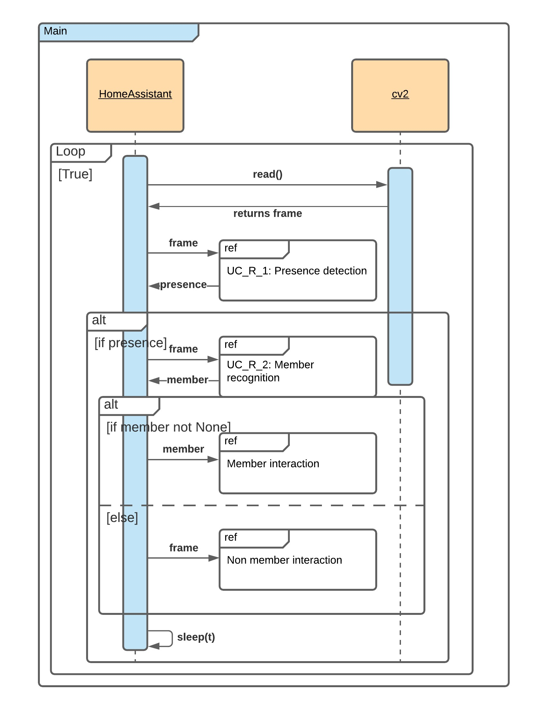
Interactions
The Home Assistant detects of a person
The Home Assistant recognizes a member
The Home Assistant register a member
A member leave a note to another member
A member edit a note they left
A member delete a note they left
The Home Assistant tells the notes to a member

Slide 8
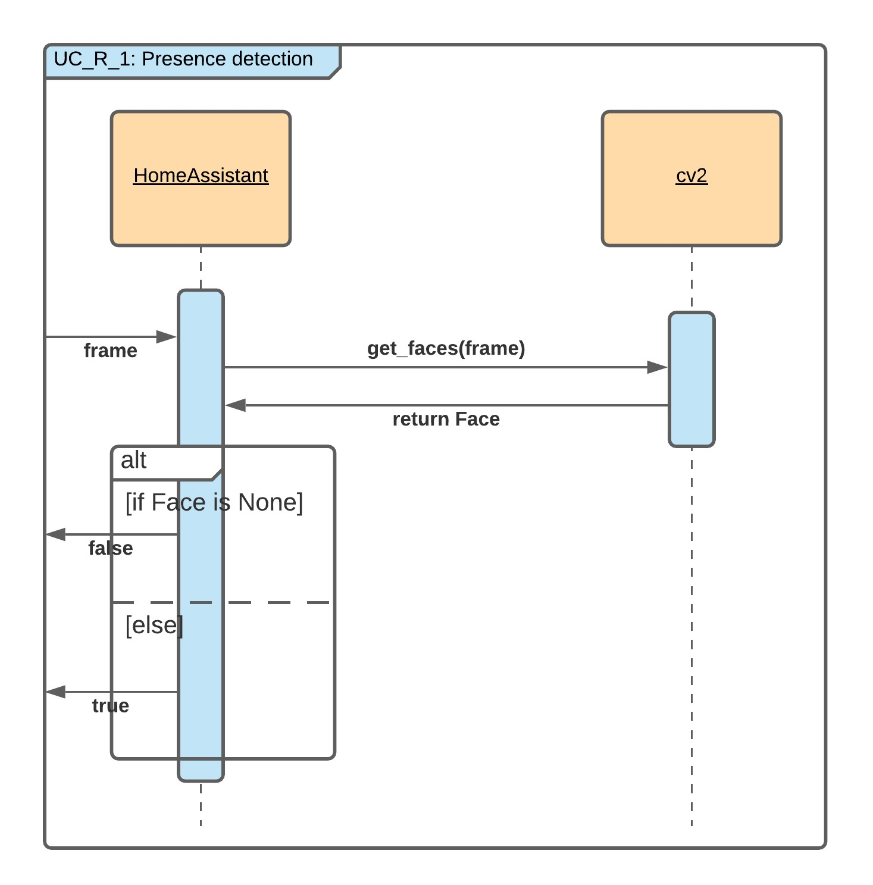
Interactions

Slide 9
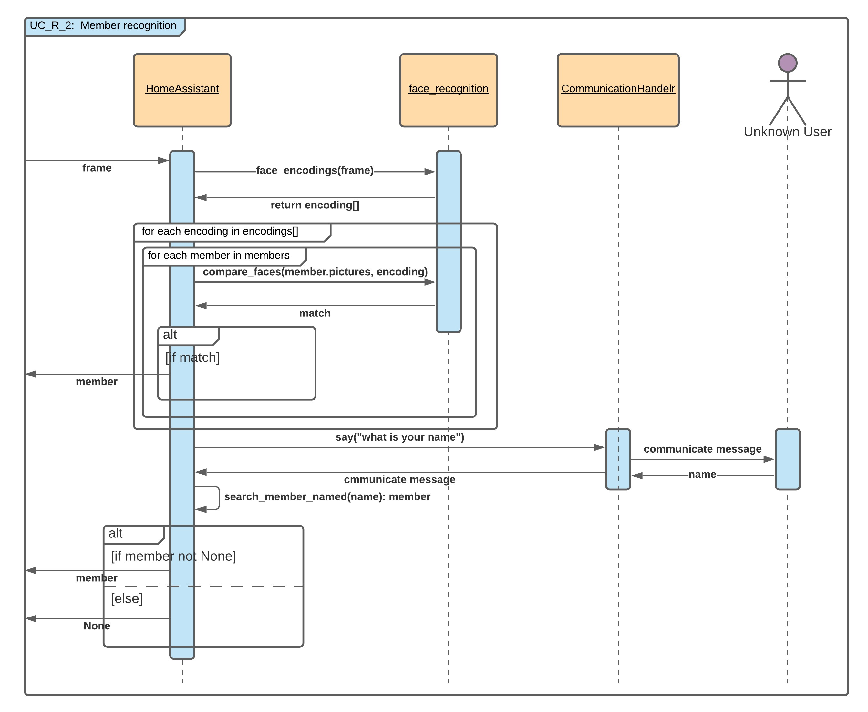
Interactions

Slide 10
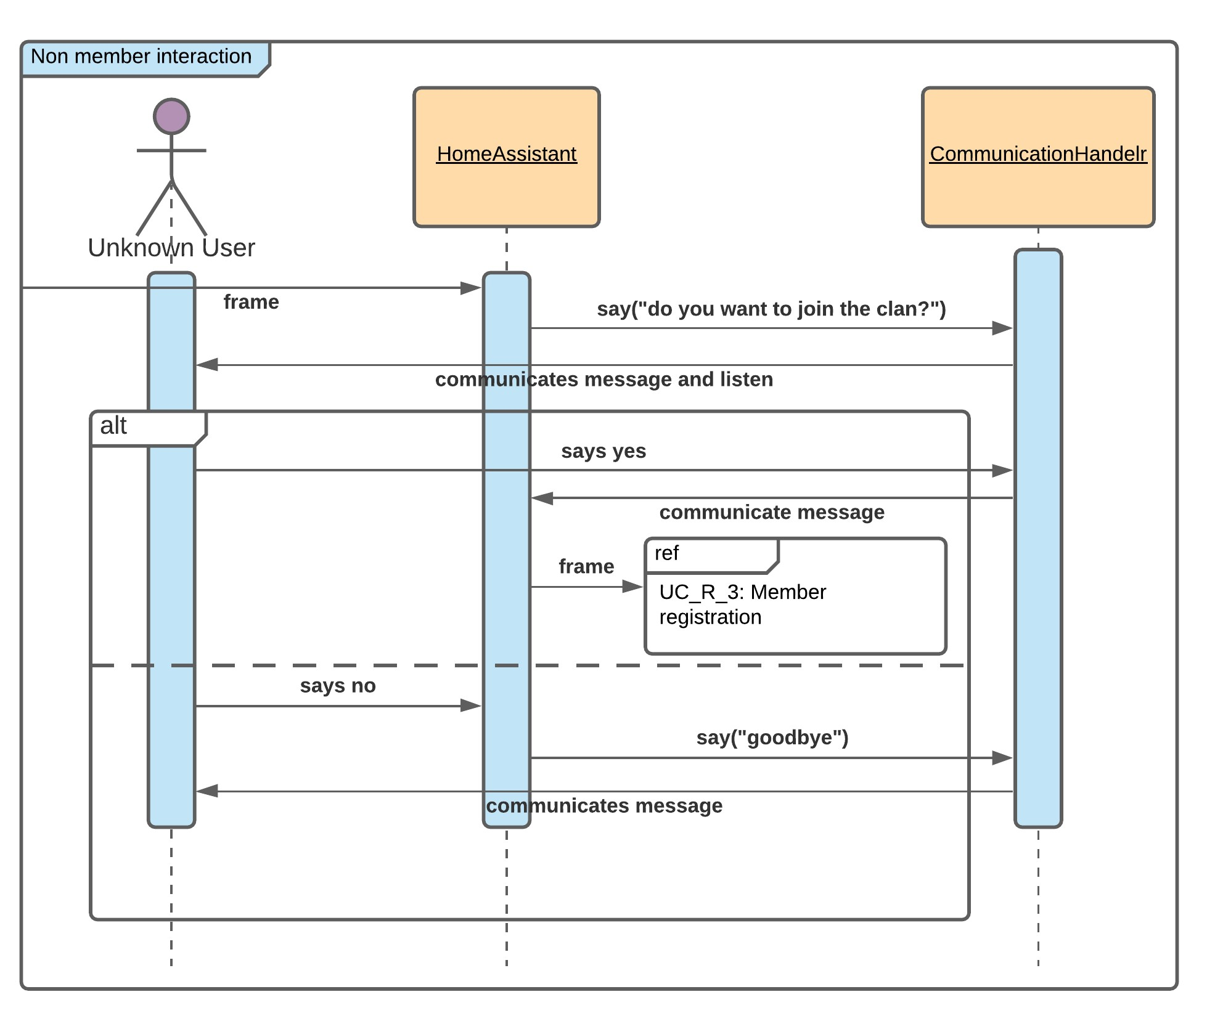
Interactions

Slide 11
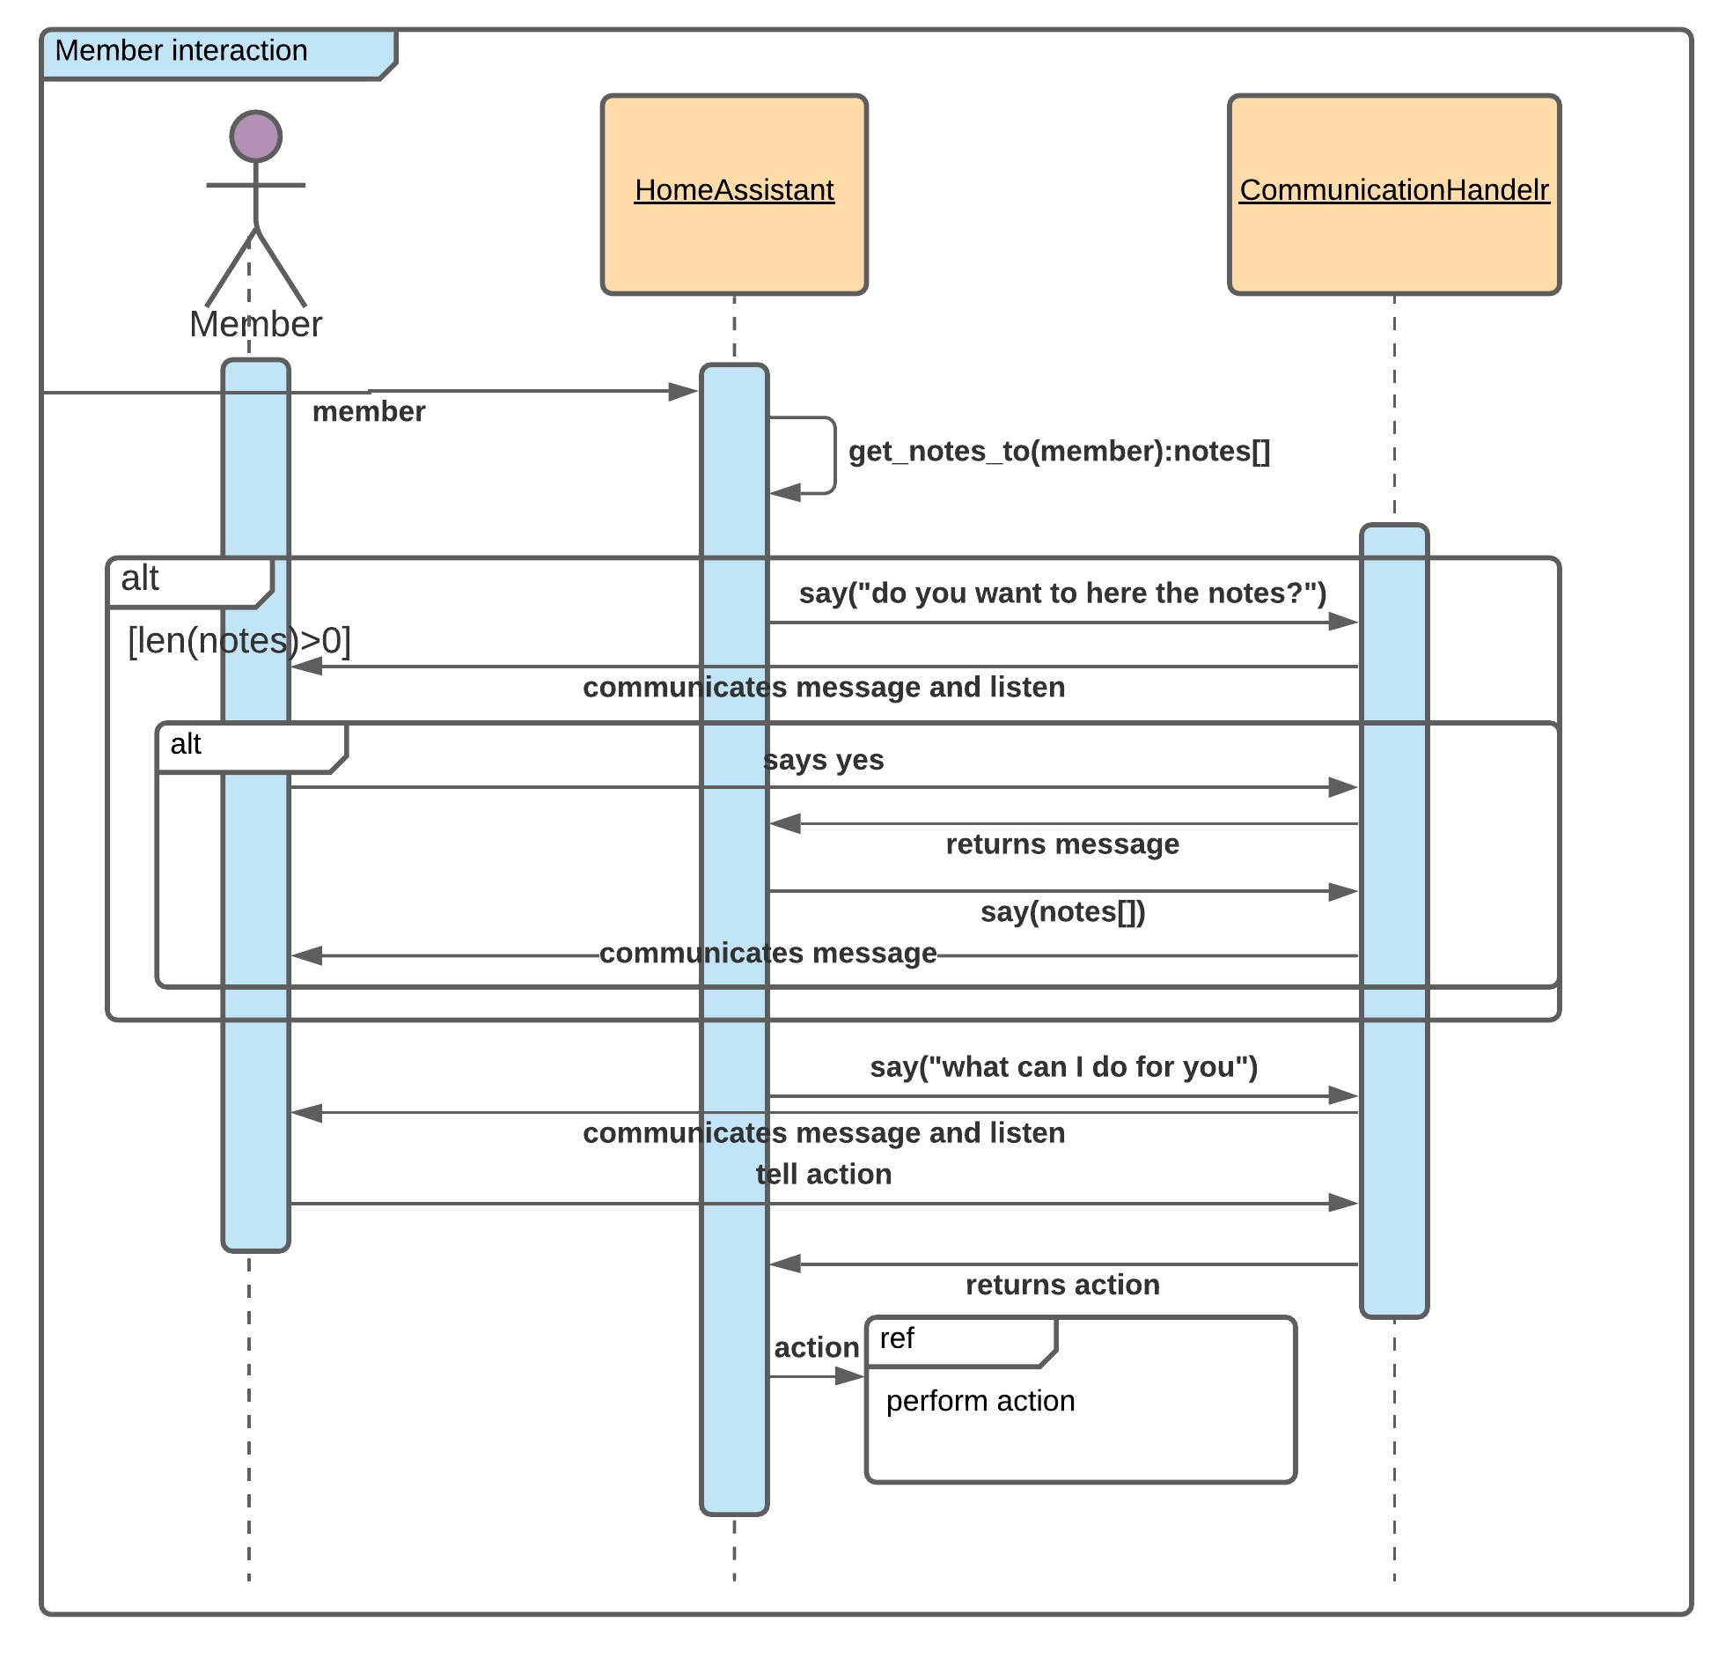
Interactions

Slide 12
Interactions
Actions:
Possible actions:
“”
Hot-words based selection

Slide 13
Interaction structure pt. I: recognizing a user
Once the device is turned on, it should be placed somewhere where the user wants to be and can be easily identified, recognized and interacted with
The assistant will continuously monitor the camera searching for a successful detection
Once a face is detected, it attempts to recognize the person automatically
Failsafe: should recognition fail, ask the person to pronounce their name

Slide 14
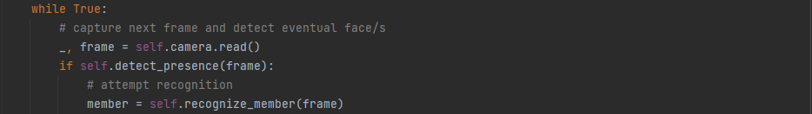
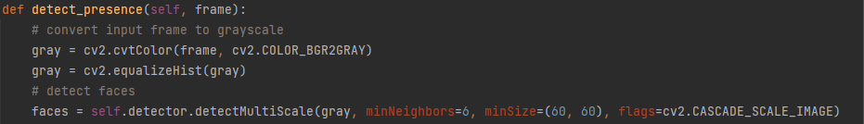
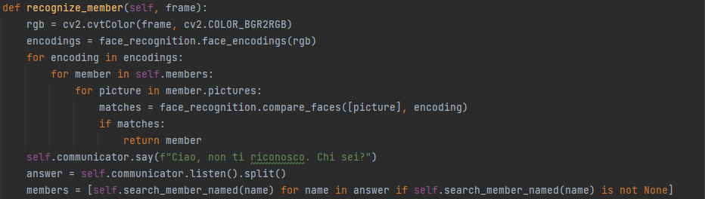
Interaction structure pt. I: recognizing a user
Three steps are involved in making the interaction happen:
Start the camera and a continuous loop where we gather the current image the camera is receiving
Send the captured frame over to the detect_presence method:
Converts the frame in B&W
Uses the preloaded opencv CascadeClassifier with Haar Cascades to attempt detection
Attempt recognizing the person from the frame they have been detected in:
Generate face encodings for each face
Compare each encoding to the ones locally saved for each member until there is a match
If all else fails, ask the person to identify themselves by using voice

Slide 15
Interaction structure pt. I: what if they can’t be recognized?
Recognition will always fail (both visual and audio identification) if the person is not registered to the system in the first place
Solution: ask and offer the possibility for a person to register to the system
Registration is made simple, only asking for a name, as the image has already been encoded beforehand

Slide 16
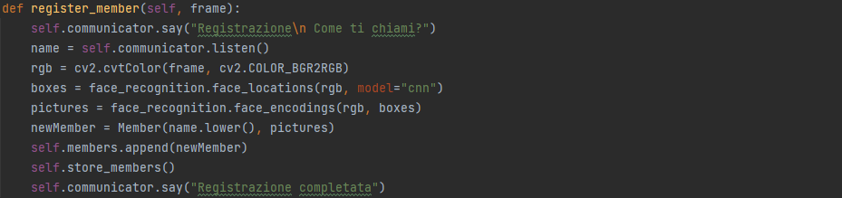
Interaction structure pt. I: what if they can’t be recognized?
As said: registering is straight-forward:
Ask the name which the person wants to register with
We ask again as they might want to register with a name different from their real one!
Compute face encodings from the detection frame (the frame that started it all)
Create a new instance of the Member class, commit it to memory, and inform the user they are now part of the Clan

Slide 17
Interaction structure pt. II: let’s have a talk
Once a user is successfully recognized, interaction begins
The assistant initiates it, greeting the user and informing them of (eventual) pending notes left by other users of the same device
If the user is still in the room, it will further interact, asking if they want to leave notes for others, or remove or edit unheard notes they sent
Interaction terminates any time the user asks for exiting or leaves the camera frame entirely

Slide 18
Demo

Slide 19
Conclusion and future works
New functionality that overcomes one of the major limitations of present-day home assistants (i.e., personalized multi-user interaction).
New interaction modality has been introduced extending the possible channels through which the interaction is conveyed.
Diversity aware development
Future works:
Exploit visual modality to recognize gesture interactions and sign languages
Exploit auditory modality to recognize members also by voice

